Slide 1

Project
Smart Energy
Design Highlights
The smart energy monitor that we have created is a proof of concept prototype for a system to measure the energy usage of a household appliance in New Zealand.
To improve convenience and accessibility, we decided to implement a smart energy interface.
The CPLD is able to send the calculated values to a personal computer via RS232 serial communications. The data values are processed locally by a Python script and displayed as a real time graph. This would help an everyday user to track, log, and analyse the energy usage for that appliance.
Furthermore, we implemented a Firebase real time database which the Python script uploads the data to. This is accessed by an Android application, allowing consumers to view real time data and graphing on their smartphone, over the internet.
There are a number of highlights in the design choices for our smart energy monitor. These include:
Multiple amplifier circuits for the current sensing design. At low loads the output from the recommended amplifier is relatively small, so the output signal was greatly affected by small amounts of noise. Therefore we added an additional high gain amplifier in order to provide a larger output signal and increase accuracy at low loads. The high gain amplifier is only used at low loads because it begins to clip at higher loads.
External interrupt triggered by zero crossing detector. This enabled the microcontroller C software to start ADC readings at the rising zero crossing of the voltage sine wave, thus increasing accuracy when calculating rms and average values.
Mealy FSM implemented in VHDL on the CPLD. A Mealy FSM which selected due to its faster reaction to inputs. Mealy FSMs react in same clock cycle as an input, reducing communications and display delays.
Multithreading implementation for the Python script. Serial reading, data processing, and graphing all run on separate threads in the Python script. This allows the processes to run concurrently, dramatically increasing the speed of data uploading and allowing graphing in real time.
Basic System
Our system measures the voltage and current across a load through an analogue circuit. This analogue circuit includes a current shunt resistor as well as signal conditioning to provide measurable voltages from the AC input.
These voltage signals are measured by a microcontroller based digital processing system via ADC. From the input signals, rms voltage, peak current, and average power are calculated. The calculated values are transmitted to a CPLD via radio frequency UART.
The CPLD based digital display system receives the transmitted calculation values. The values are displayed on a seven segment display with the appropriate unit.
Microcontroller
CPLD
Specifications
Computer
The proof of concept prototype that we created is able to work with the following specifications:
Source Voltage: 12 to 14 V_{rms}
Source Frequency: 500 Hz ± 10%
Maximum Load: 8.5 VA
Firebase
Android App
Background image from: https://upload.wikimedia.org/wikipedia/commons/e/ef/ISS-42_New_Zealand_in_Sunglint,_large_resolution.jpg

Slide 2
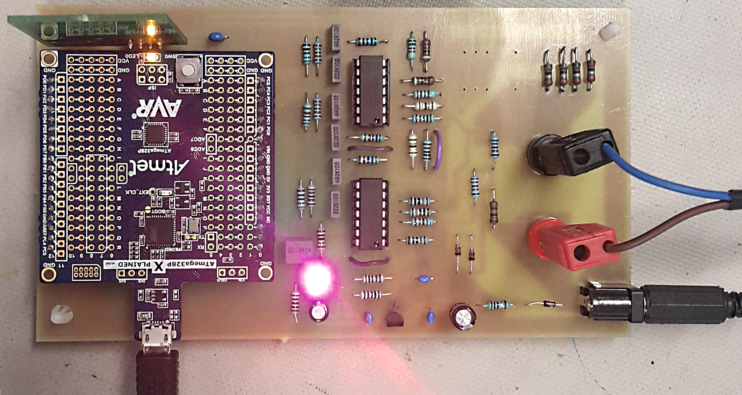
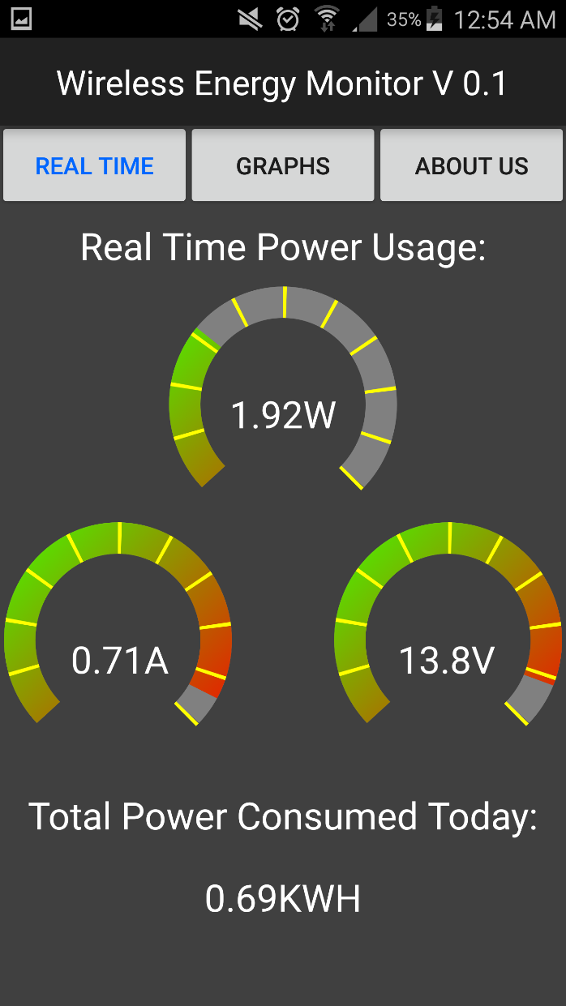

Technologies and Frameworks
A Smart Energy Monitor
Throughout our entire project we utilised many current frameworks and technologies. These include:
Analogue Circuit Design
LTSpice
Altium
Version Control System
GitHub
Microcontroller C
Atmel Studio
VHDL
Altera Quartus
Python
RS232 serial data – pySerial library
Real Time Graphing – matplotlib library
Firebase – Firebase library
Firebase
JSON
Google Requests
Android App
Android Studio
Firebase dependencies
Google Requests dependencies
ELECTENG 209
Smart Energy Challenge
Group 37
James Ashworth
Adil Bhayani
Savi Mohan
Mark Yep
With thanks to:
Muhammad Nadeem
Duleepa Thrimawithana

